Slide 1

Optimization and Probability
Evolve Machine Learners
Notes:
https://techxplore.com/news/2018-02-google-ai-heart-disease-pictures.html

Slide 2

Optimization

Slide 3
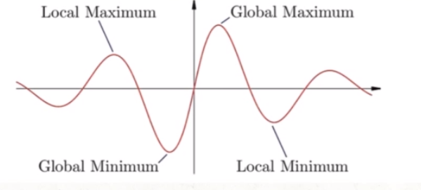
Optimization seek to find the Global Minimum of objective function

Slide 4
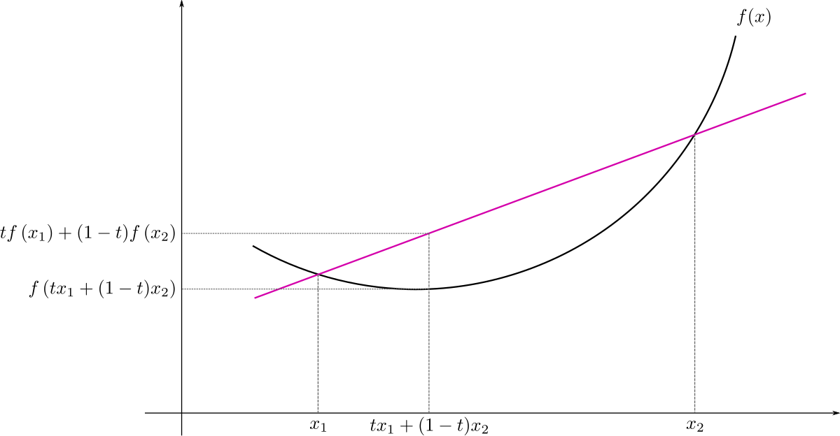
If objective functions is convex, we call it convex optimization

Slide 5
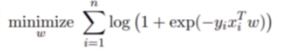
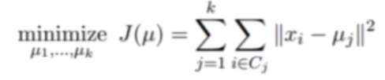

Classification
K-Means
Logistic Regression

Slide 6
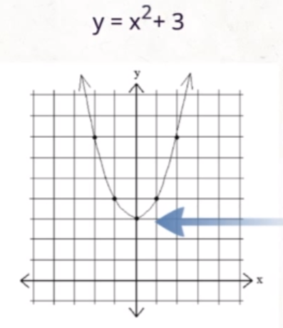
Finding Extrema with Calculus
Example Problem: y = x² + 3
Derivative is 0 at:
Local minimums
Local maximums
Global minimums
Global maximums

Slide 7
1st Derivative of f(x)
2nd Derivative Test
y = x² + 3
yʼ = 2x
0 = 2x
x =0
yʼ = 2x
yʼʼ = 2
If the 2nd derivative is positive, it is a minimum. If the 2nd derivative is negative, it is a maximum

Slide 8
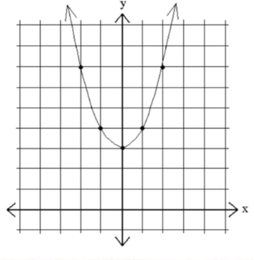
2nd Guess - x = -1 is the minimum
Evaluate f(x) - y = (-1)² + 3 = 4
Evaluate derivative - yʼ = 2(-1)² = -2
Update the guess - x = 0 is the minimum
1st Guess - x = 3 is the minimum
Evaluate f(x) - y = (3)² + 3 = 12
Evaluate derivative - yʼ = 2(3) = 6
Update the guess - x = -1 is the minimum

Slide 9

Data

Slide 10
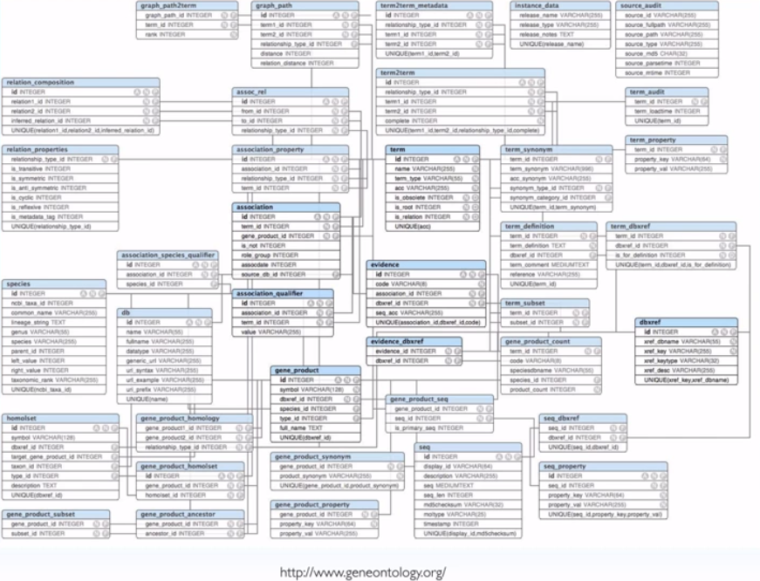
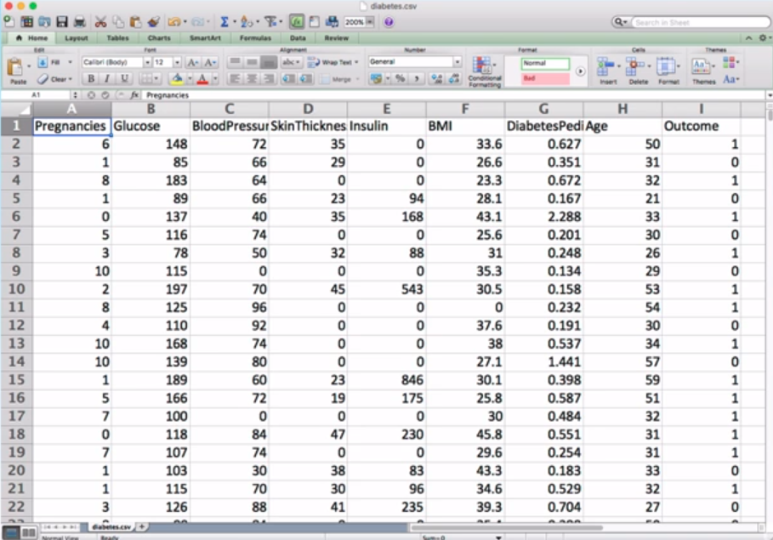
Tabular Data (Structured Data)
Columns
Row
CSV, TSV, Excel, Databases (Collection of tables)

Slide 11
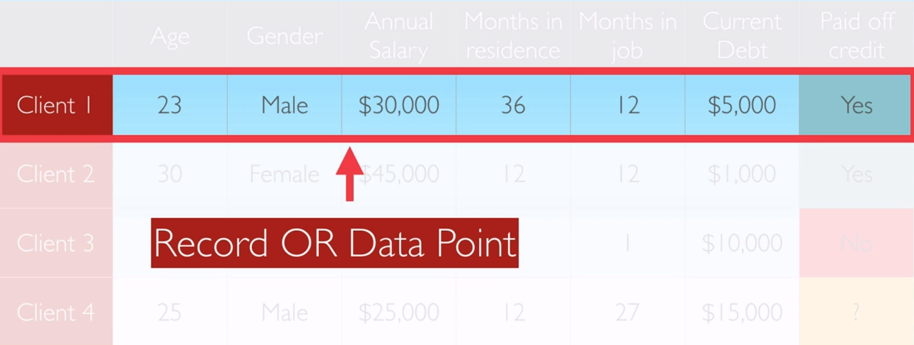
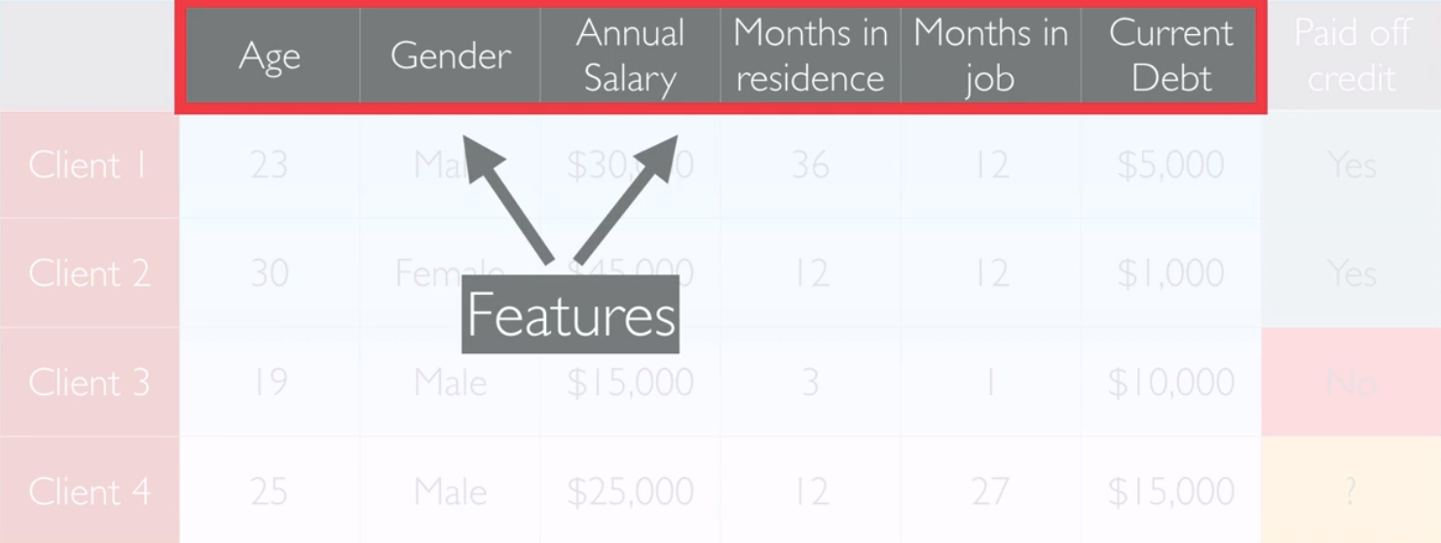
Features….
Measured
Calculated (Engineered)

Slide 12
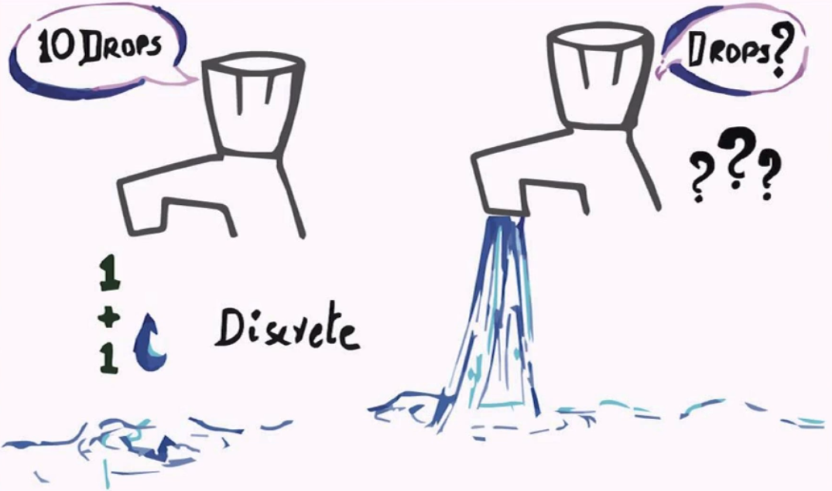
Data Types
Categorical | Continuous
Eye Colors | Height of Children
Courses at University | Weight of cars
Gender | Temperature
Spam or Not | Stock Price

Slide 13
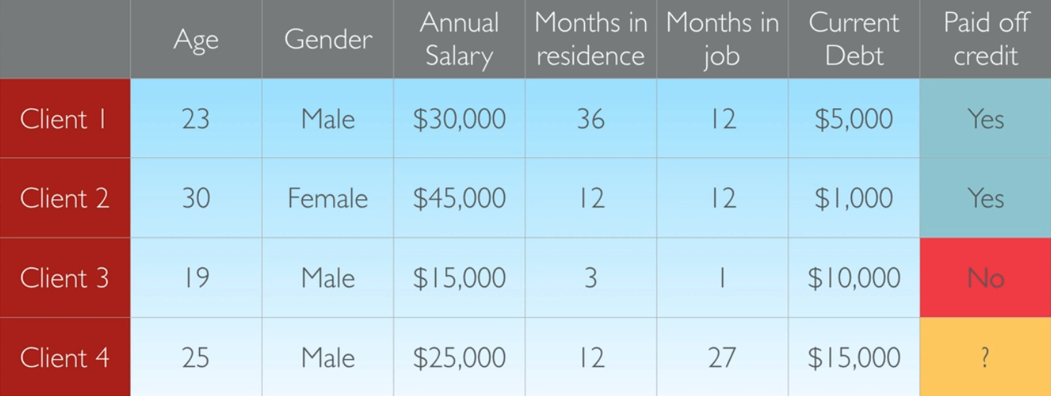
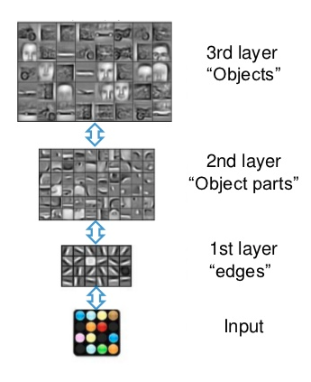

Slide 14
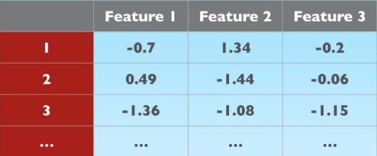
Unstructed Data
Images
Sound
Text
Video Games
….
?
Notes:
FEATURE EXTRACTION

Slide 15

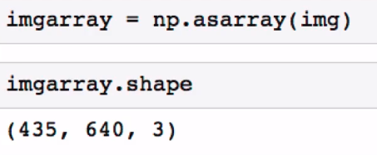
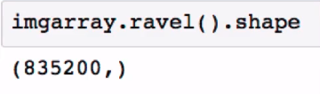
0 0 0 .5 .5 .1 .1 0 0 0 .1
information is loss (pixel is correlated with each other)

Slide 16
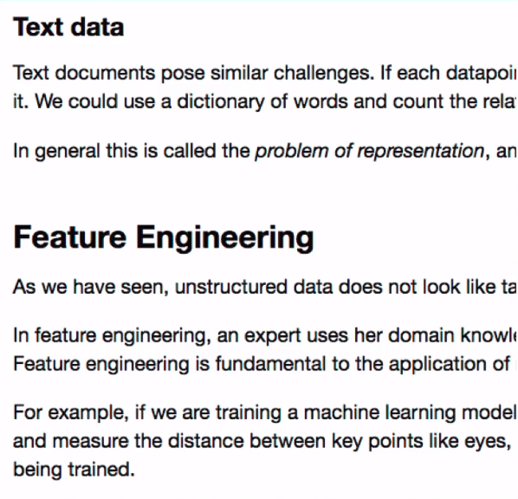
TEXT
Parts of speech
Words frequency
Embeddings

Slide 17
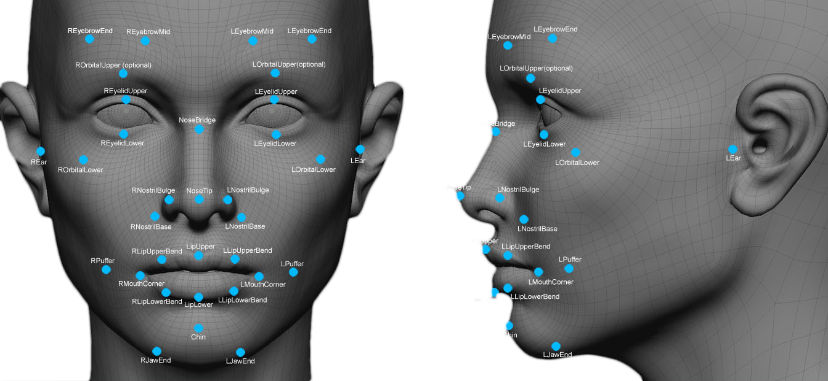
Feature Engineering
Feature can be calculated or measured (feature engineering)
Needs expert
Domain Knowledge
Very Powerful
Difficult
Ekspensive

Slide 18

Mean, Mode, Median

Slide 19
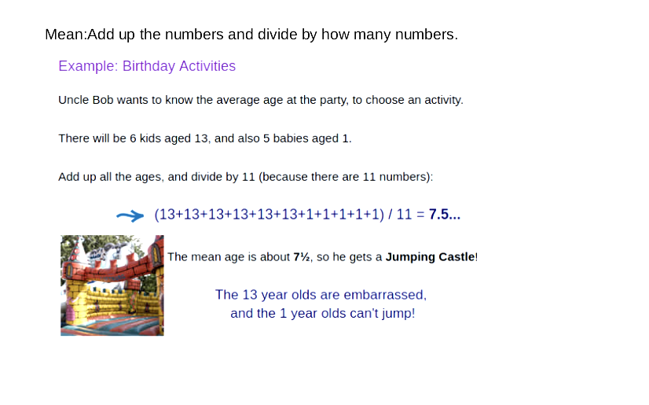
Mean

Slide 20
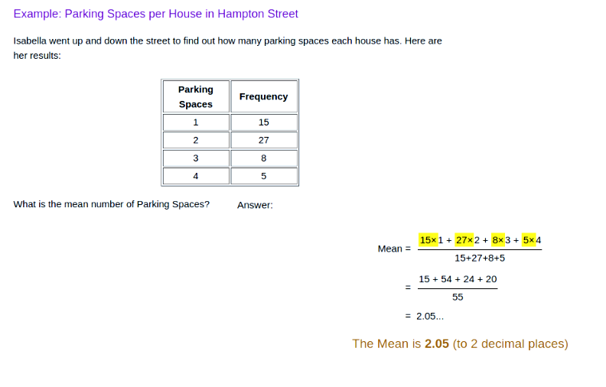

Slide 21
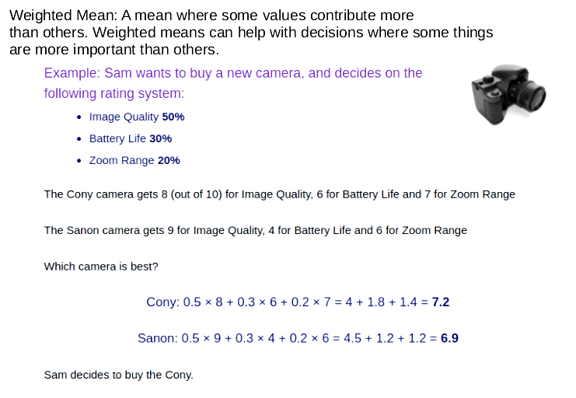
Weighted Mean

Slide 22
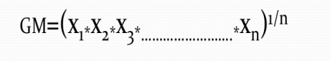
Geometric Mean
Geometric mean is defined as the positive root of the product of observations
Symbolically,
Example,
Observation = 6,8,10,5,18
GM = (6*8*10*5*18)^⅕ = (43200)^⅕ = 8.454

Slide 23
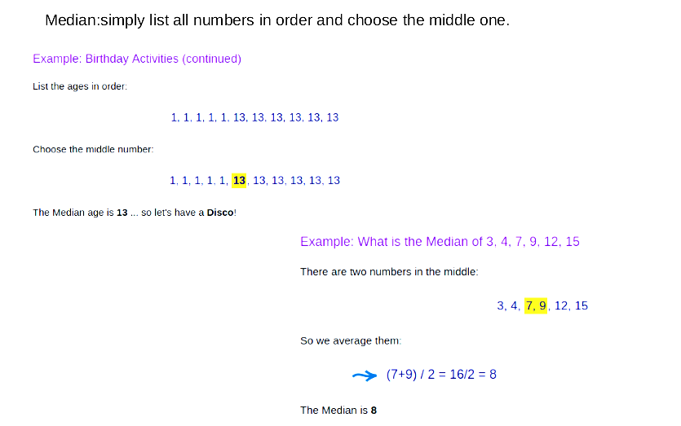
Median

Slide 24
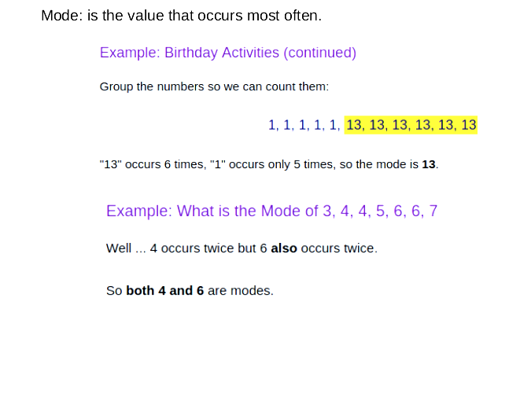
Mode

Slide 25
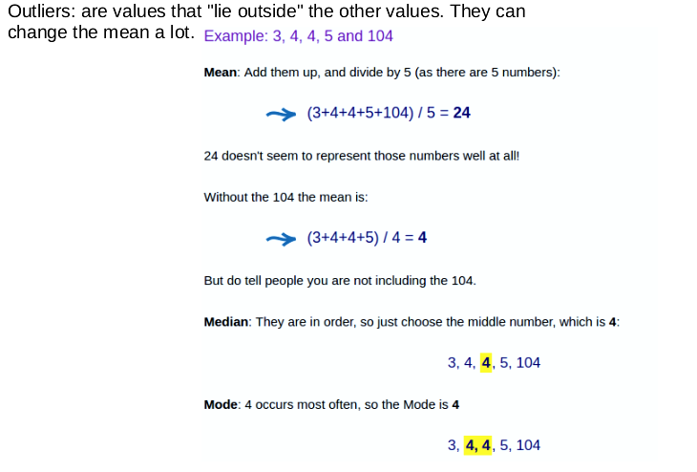
Outliers

Slide 26

Probability

Slide 27
Why Probability Theory?
Probability theory provides a means of quantifying uncertainty
Provides axioms for deriving new uncertain statements
Probability Theory in Artificial Intelligence
Laws of probability tells us how AI should reason
We can use probability theory to analyze the behaviour and decisions of AI systems

Slide 28
Sources of Uncertainty
Inherent stochasticity in the system being modeled
Ex. Model of quantum mechanics
Incomplete observability - we do not have or cannot observe all the variables
Ex. Economic Models
Incomplete modeling - we use a model that discards of some observed information
Ex. A simplified model of the brain

Slide 29
Types of Probability
Frequentist Probability - frequency of events
Example: chance of drawing certain hand in poker
Bayesian Probability - a degree of belief
Example: a doctor saying a patient has 40 percent chance of having the flu

Slide 30
Random Variables
Variable that can take different values randomly
x1, x2, x3, …, xn possible values the variable x could be
Probability distribution specifies how likely each of value/states is occur
Random variable → continues (Real Values) or discrete (Name states)

Slide 31
Probability Mass Functions
Probability distributions for discrete random variables are referred to as probability mass functions (PMF)
Three criterion for being a PMF:
The domain of P must be the set of all possible states of x
0 ≤ P(x) ≤ 1
Σ P(x) = 1

Slide 32
Types of Distributions
Joint Probability Distributions
P(x =x, y = y) denotes the probability x = x and y = y simultaneously.
Uniform Distribution (Normalized)
Each state of the distribution is equally likely
P(x = xi) = 1/k
Σ P(x = xi) = Σ 1/k = k/k = 1

Slide 33
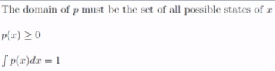
Probability Density Functions
Probability distributions for continuous variables are called probability density functions (PDF)
To be a PDF, the function p must satisfy:

Slide 34
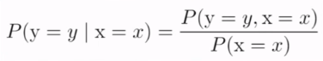
Conditional Probability
The probability of some event, given that some other event has happened
The conditional probability that y = y, given x = x

Slide 35

Expectation, Variance, Covariance

Slide 36
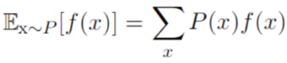
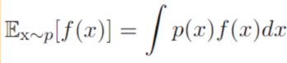
The Expectation
The expectation of some function f(x) w.r.t some probability distribution P(x) is the mean value f takes on when x is drawn from P
For Discrete Variables
For Continuous Variables

Slide 37
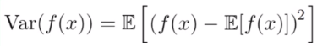
Variance and Standard Deviation
Variance (𝞂²): (Formally) The expectation of the squared deviation of a random variable of its mean. (Informally) Measures how far random numbers drawn from a probability distribution P(x) are spread from their average value.
Standard Deviation (𝞂): The square root of the variance

Slide 38
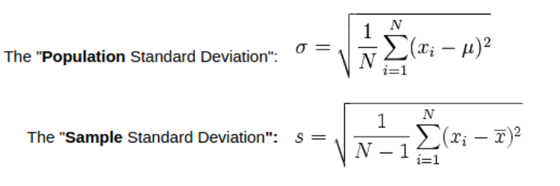
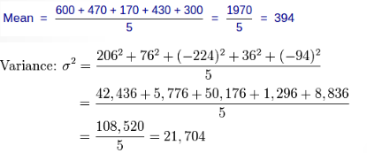
Example

Slide 39
Covariance
Measure of how much two variables are linearly related to each other.
High absolute value - values are both far from their respective means at the same time
Positive - both variables take on large values simultaneously
Negative - variables takes on large values at different times
Notes:
Covariance effected by scale
The notion of covariance and dependence are related:
Independent (0 covariance)
Dependent (non-zero covariance)
FIND LINEAR DEPENDENCY

Slide 40
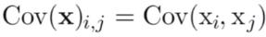
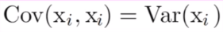
The Covariance Matrix
The covariance matrix of a random vector x is an n x n matrix, such that:
The diagonal elements of the covariance matrix give the variance:

Slide 41
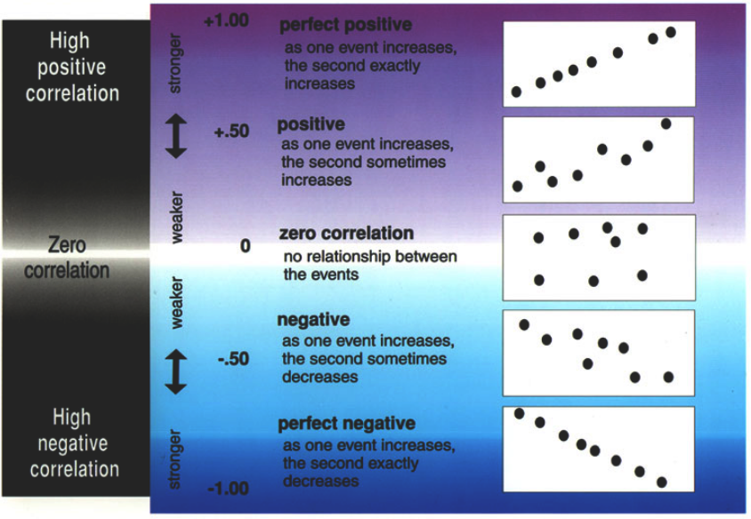
Correlation Methods
Pearson Correlation
Spearmans Correlation
Hoeffding’s D Correlation

Slide 42
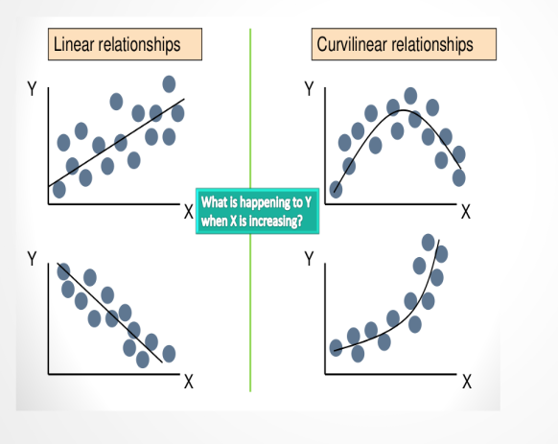
Type of relationship

Slide 43
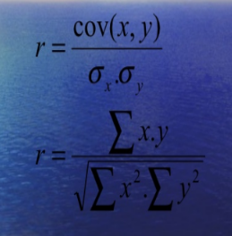
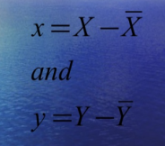
Karl Person Correlation Coefficient
Where

Slide 44
Problem
From the following data find the coefficient of correlation by Karl Pearson method
X: 6 2 10 4 8
Y: 9 11 5 8 7

Slide 45
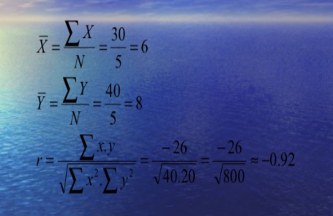
X | Y | X-6 | Y-8 | x² | y² | x.y
6 | 9 | 0 | 1 | 0 | 1 | 0
2 | 11 | -4 | 3 | 16 | 9 | -12
10 | 5 | 4 | -3 | 16 | 9 | -12
8 | 8 | -2 | 0 | 4 | 0 | 0
4 | 7 | 2 | -1 | 4 | 1 | -2
30 | 40 | 0 | 0 | 40 | 20 | -26

Slide 46

Project

Slide 47

Unsmoothed Maximum Likelihood Character Level Language Model
Human → “ello” → ? (comma or space if its “hello” or “w” if it’s “melllow”)
History (order) of 4 (n) → the number of letters we need to guess on
Model
n → n+1?
P(c|h) → h = n-letters history

